Slide 1



Terrainosaurus
Terrain Generation
Using Genetic Algorithms
Thesis defense of
Ryan Saunders
July 18th, 2005
Committee
John Keyser, advisor
Glen Williams
Don House

Slide 2

Overview
Introduction
Motivation
  Applications of terrain generation
  Current terrain generation methods
  Our goals
  Terrain model representation
The algorithm
Discussion & Results
Conclusions & Future Work

Slide 3
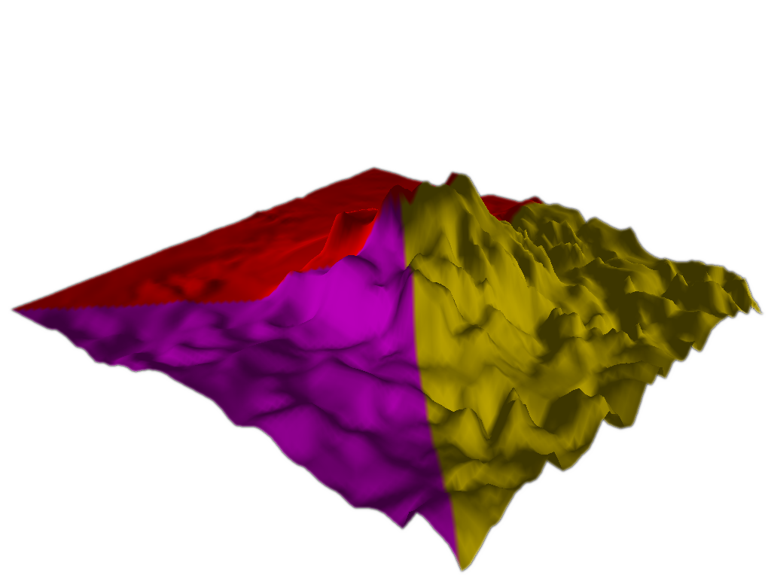
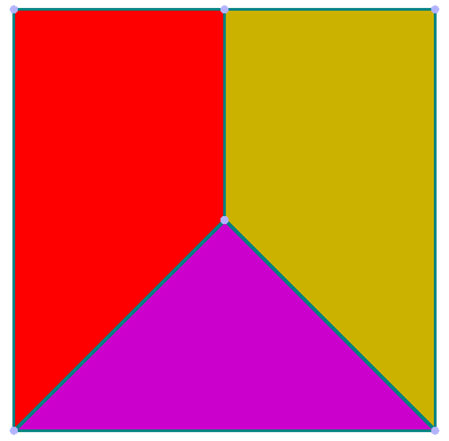


Introduction
What I’m doing
Terrain generation
  Existing methods are limited: too unrealistic, or else too much work
A new way of generating terrain
  User-oriented
  Physically-based
  Extensible
Basic idea: let the user design by example, and let a genetic algorithm do the hard work

Slide 4

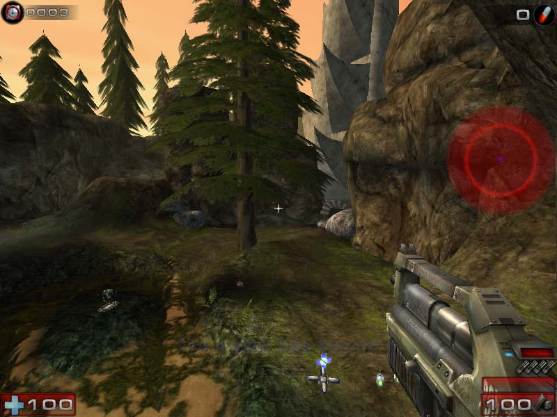
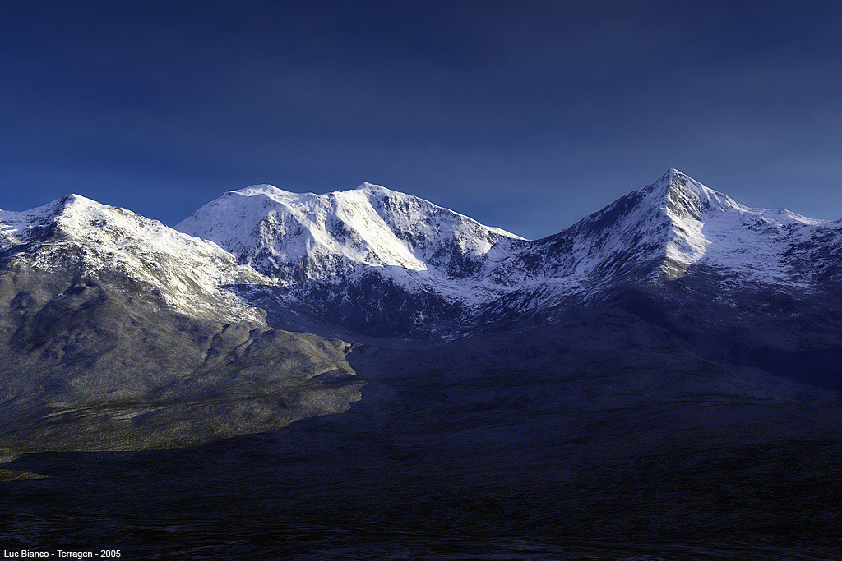

Applications of Terrain Generation
Why would you want to do this?
Art
Architectural rendering
Training exercises
CG movies
Games
1
Images ©:
1. DreamWorks, LLC
2. Epic Games, Inc.
3. Luc Bianco
2
3

Slide 5
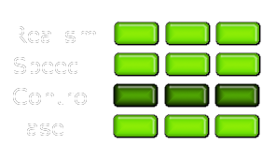
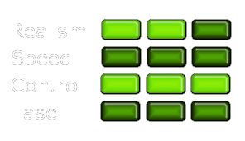
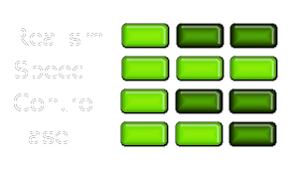
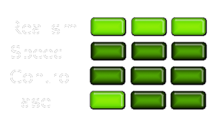
Current Terrain Generation Methods
Strengths & Weaknesses
GIS Data
Sculpting (e.g., Terragen)
Procedural (e.g., fractals)
Simulation (e.g., Erosion3D)

Slide 6
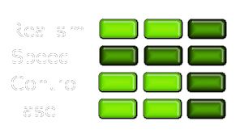

How Terrainosaurus is Different
Where we fit in
Goals of Terrainosaurus
  Realism
  Extensibility
  Ease of use
The result
  More control than fractals
  Less work than sculpting
  Realism approaching GIS
A good solution for non-real-time, authoring applications
Terrainosaurus

Slide 7
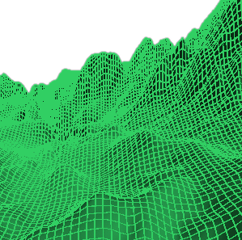
Terrain Model Representation
Height fields are our friends…
Height field
  Regular, 2D grid of elevations
  Equivalent to a greyscale image
Advantages
  Commonly used, easily implemented
  Real-world surveying data available
  Ideal for rendering & collision detection

Slide 8
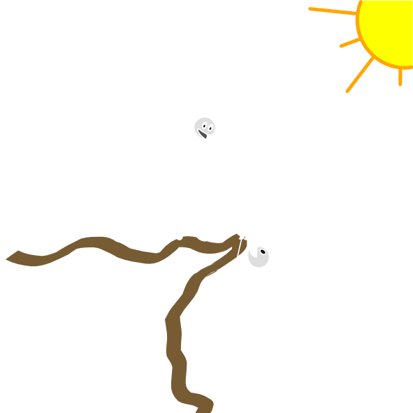
Terrain Model Representation
…but they do have problems
Height field
  Regular 2D grid of elevations
  Equivalent to grayscale image
Disadvantages
  Precludes representation of caves & overhangs

Slide 9
Overview
(again)
Introduction
Motivation
The algorithm
  Phase I: Construct a terrain type database
  Phase II: Design the terrain layout
  Phase III: Generate the height field
Discussion & Results
Conclusion & Future Work

Slide 10
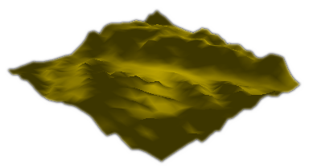
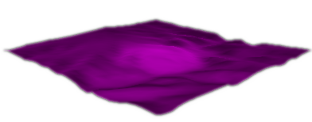

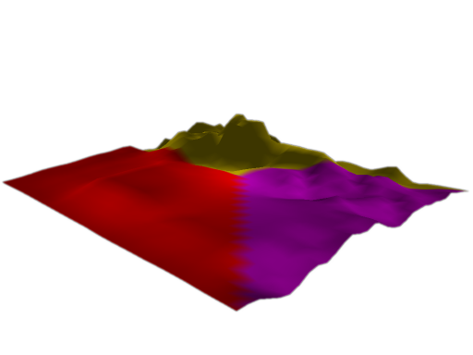
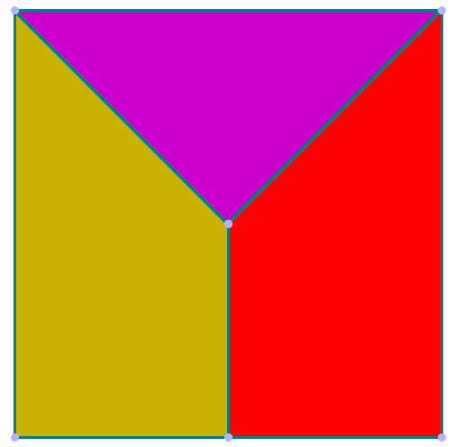
The Algorithm
The Big Picture
User designs terrain using intuitive, low-effort inputs
  Terrain characteristics are specified by example, using real-world GIS terrain data
  The layout of the terrain is created visually, by drawing a “map”
  The GA creates a height field matching these inputs

Slide 11
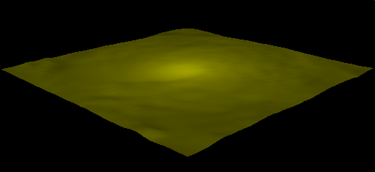
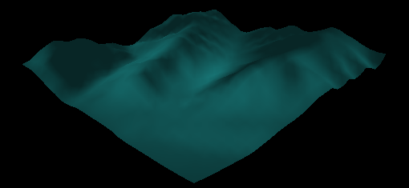
Phase I
Constructing a terrain library
Flat terrain from Florida
Mountain terrain from Washington
The user creates a database of example height fields
  Normally, these are from real-world data from GIS sources
  He classifies them into logical terrain types (e.g., “desert”)
  This forms the user’s “palette” of terrain

Slide 12
Phase II
Laying out the terrain
Utah Foothills
Most of the user’s work is done here, designing the terrain
This is done visually, with a CAD-style interface, a la Maya or AutoCAD
The user sketches his design as a “map” of 2D polygonal terrain regions
Each region is assigned a terrain type
Texas Desert
Wyoming Mountains

Slide 13


Phase II
Refining region boundaries
Polygonal shapes are useful for rapid design, but are not natural
  Occasionally apparent in the generated geometry
  Painfully obvious when texturing or coloring is applied
But making irregular shapes by hand is tedious!
Thus, we provide a boundary refinement operation

Slide 14
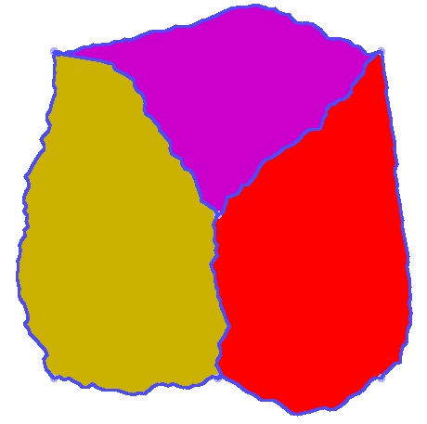
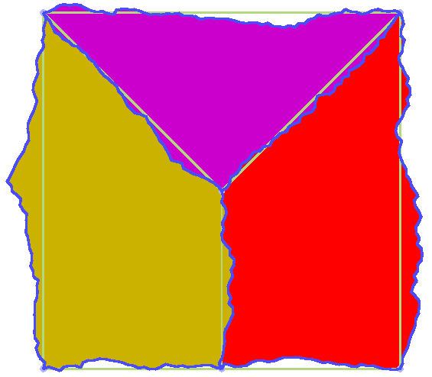
Phase II
Refining region boundaries
The refinement operation
  Essentially, randomized subdivision
  Desired shape controlled by a smoothness parameter
Results with different
smoothness values

Slide 15

Phase II
Encoding a boundary
A boundary is
  Logically, a series of 2D Cartesian points
  Encoded as a series of relative angles between segments
    α ∈ [ -π, π ] → ƒ ∈ [-1,1]
This form is convenient for performing mutations and crossover

Slide 16
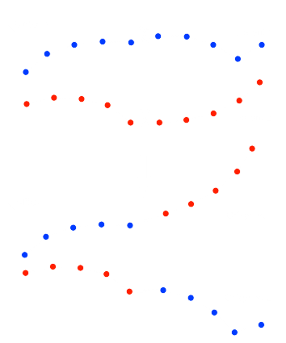
Phase II
The crossover operator
Genetic exchange is done with a standard crossover operator
This is equivalent to cutting and splicing the world-space boundaries

Slide 17
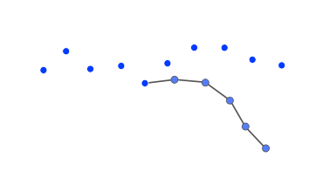
Phase II
The mutation operator
Mutation is also done with a standard operator
This is equivalent to randomly “bending” the boundary at one of the points

Slide 18
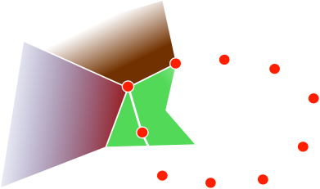
Phase II
Preventing unreasonable results
One problem that arises with this scheme is that the boundary can “double back” on itself
If this happens, the boundary will be badly scaled
We solve this by imposing a global limit on the absolute angle

Slide 19
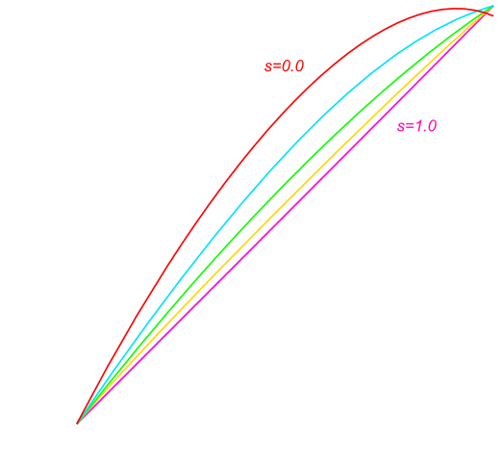
Phase II
The fitness evaluation
The fitness of a candidate boundary is found by averaging the smoothness of all of the genes

Slide 20
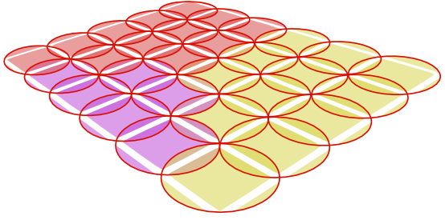
Phase III
Encoding a height field
The genes are arranged into a 2D grid
Each gene is responsible for a small region of the height field (e.g., 16x16 pixels)
The height field can be reconstituted by blending together the genes’ data

Slide 21
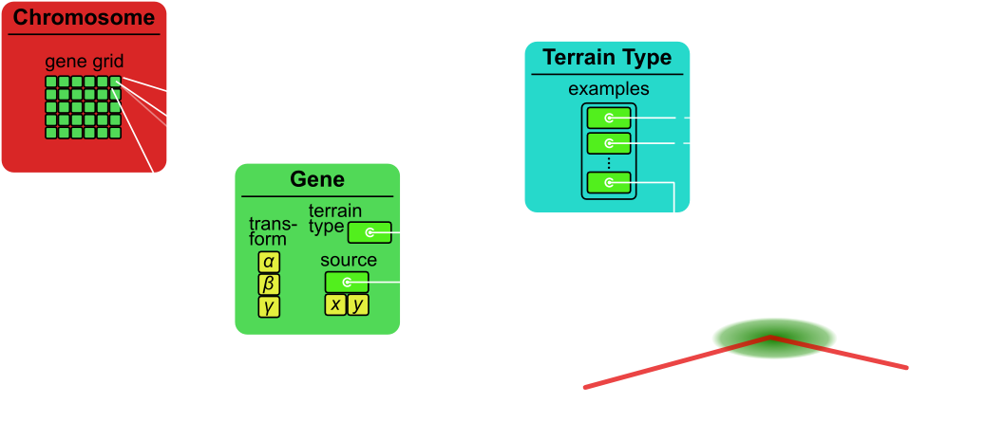
Phase III
Encoding a height field (cont’d)
Each gene encodes the image processing instructions to reconstruct its part of the height field:
  A pointer into one of the examples for its terrain type (source data)
  A set of transformation parameters

Slide 22
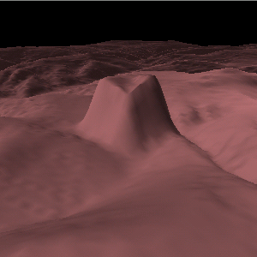
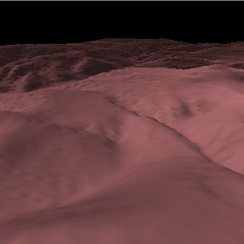
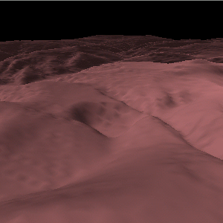
Phase III
Crossover & mutation operators
The crossover operator copies rectangular blocks of adjacent genes
Mutation operators alter the transformation parameters for a gene, or select new source data
  Inexpensive, local modifications to the terrain structure
vertical offset mutation
original
rotate mutation

Slide 23
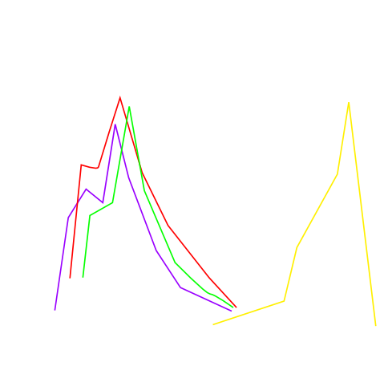

Phase III
Terrain type similarity for a region
Terrain types tend to have similar distributions
Discriminating “good” and “bad” terrain:
  Estimate the degree of similarity between statistical distributions
    Elevation
    Slope
    Length/scale of edges
    Etc.

Slide 24
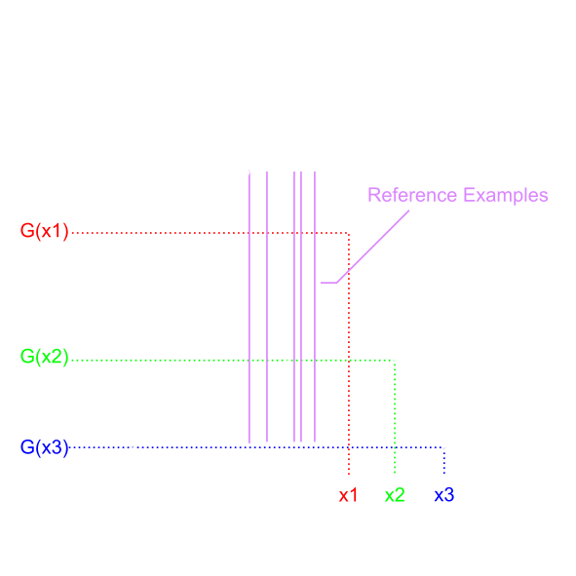
Phase III
Statistical distribution comparison
Gaussian curve projection
  A way of quantifying similarity to a group
  Converts a unbounded value to a bounded [0,1]
  Curve mean (μ) chosen to be the average of references
  Curve std dev (σ) chosen such that all references score above a certain threshold (e.g., 0.9)

Slide 25
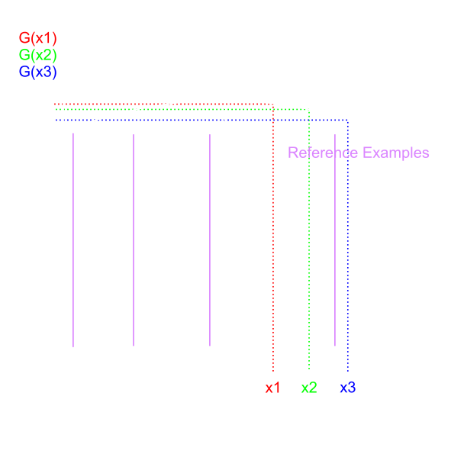
Phase III
Evaluating the evaluation
As σ becomes large, the curve looses discriminatory power
“Agreement”—a measure of terrain type coherency
  Used to weight the contributions of individual statistics
  Diminishes contribution of weaker evaluation components

Slide 26
Overview
(again)
Introduction
Motivation
The algorithm
Discussion & Results
  Generated results
  Problems with this method
  Demo
Conclusion & Future Work

Slide 27
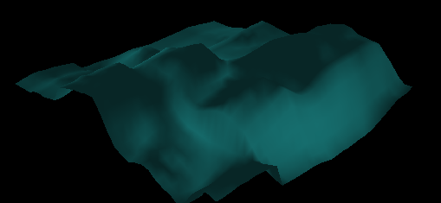
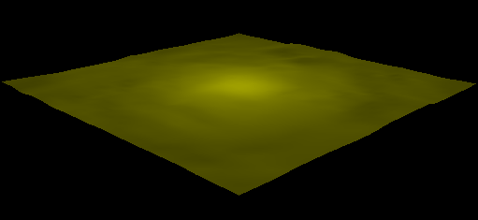
Discussion & Results
What worked…
It is successful at reproducing some kinds of terrain (especially flatter ones)

Slide 28
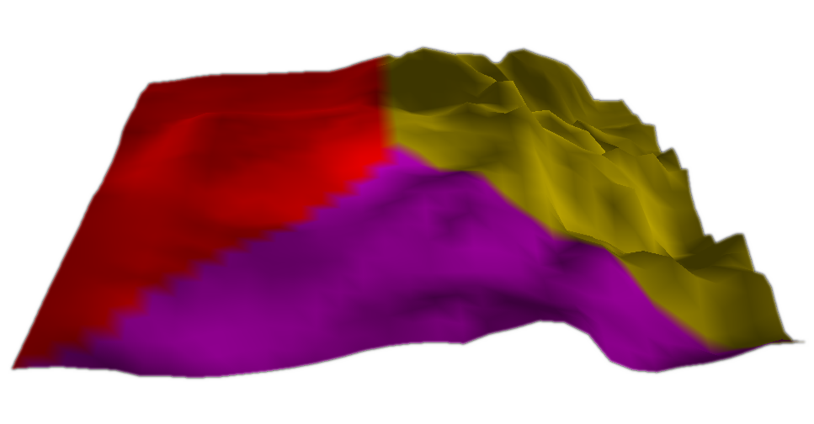
Discussion & Results
What worked…
Transitions between terrain types work smoothly
Terrain generated at 270m

Slide 29
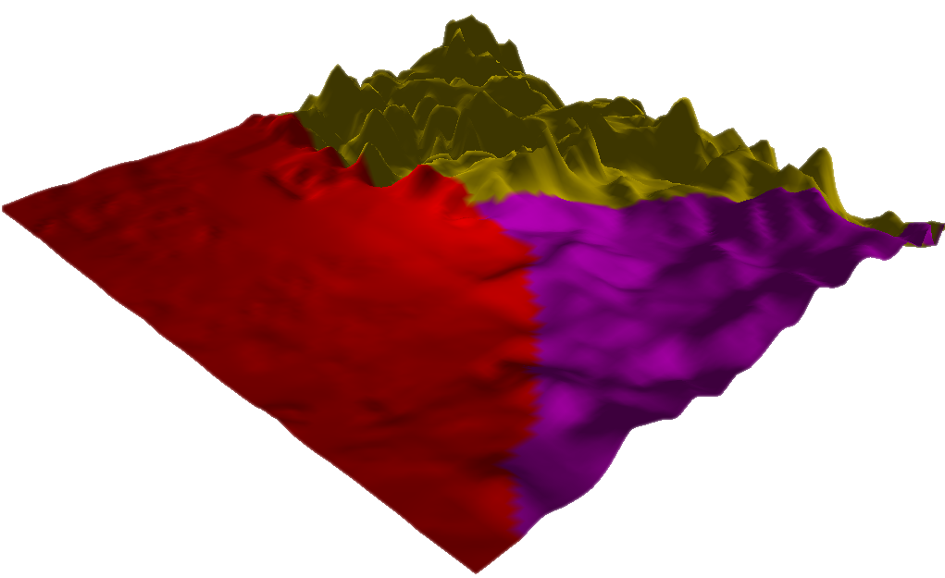
Discussion & Results
What worked…
Boundary refinement has a noticeable effect, especially when colored/textured
Terrain generated at 90m,
with boundary refinement

Slide 30
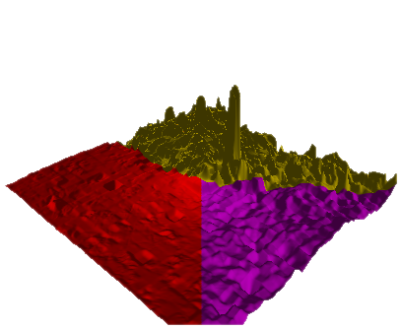
Discussion & Results
…what didn’t
Scalability is a problem for the height field GA
  The problem size grows with the level of detail…and thus, so must the population size
  Because of this (and possibly other factors), higher LODs don’t work well
  Fitness evaluation is costly
Terrain generated at 30m LOD displays a “tiling” effect

Slide 31
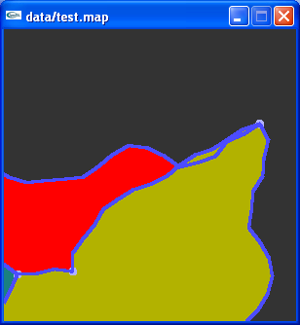
Discussion & Results
…what didn’t (cont’d)
Even with the boundary angle constraint, there can be intersections between boundaries
  Perhaps incorporate “avoid other boundaries” as a GA objective?

Slide 32
Discussion & Results
Demo & running times
DEMO!
Height Field GA Running Times
Level of Detail | Generation Time
270 m | 35 s
90 m | 270 s
30 m | 2070 s
Each successive LOD is roughly a factor of 7 slower!!

Slide 33
Conclusions
Contributions to the field
A new method of generating terrain, using GIS data and genetic algorithms
  Physically based
  Extensible
A user-friendly paradigm for designing terrain
  Uses only intuitive parameters
  The computer does the “busy work”
An adaptive method for relating and comparing terrain height fields according to measurable characteristics

Slide 34
Conclusion
Future Work
User Study
Improved height field fitness evaluation
Feature-level authoring & construction
Generation of textures & objects
Computer-aided terrain classification
Terrain type interpolation
Cross-LOD feature formation
Parallelized implementation

Slide 35
Contact
Ryan Saunders
rls@tamu.edu
Questions?
Thanks to:
Mike Ong for all the GA help
David Oertli & Neal Audenaert for the
use of their laptops
The Geometry & Graphics Group

